Slide 1
Predicting Tech Salaries: A Data-Driven Analysis of U.S. Labor Statistics
DATA 606: Capstone Project
Summer 2025- Dr. Unal Sakoglu
Team A
Dereck Román Rosario
Simran Shah
Gelareh Vakili
Notes:
“Hi everyone, we’re Team A—Dereck, Simran, and Gelareh—and our project is titled Predicting Tech Salaries: A Data-Driven Analysis of U.S. Labor Statistics.
This work is part of our DATA 606 Capstone, and today we’re presenting the results of Phase 2, which focuses on exploratory data analysis and model development.
Our goal is to bring transparency to salary forecasting by using standardized government labor data rather than self-reported sources. We’re excited to show you what we’ve learned so far.”

Slide 2
Project Repository – DevPay Insights
Project Repository:
https://github.com/DATA606-Capstone-Project/devpay-insights
Repository Highlights:
Current Status:
Organized into subfolders: data/, notebooks/, docs/, results/, and src/
Contains full EDA and modeling notebooks for both BLS and Stack Overflow datasets
Environment setup via requirements.txt; repository is MIT licensed
README outlines the project objective, methodology, and dataset usage
Actively maintained by team members: Dereck Román Rosario, Simran Shah, and Gelareh Vakili
Latest modeling and data cleansing updates pushed
Phase 2 slides will be uploaded for full documentation
Visualization outputs and code walkthroughs are accessible in notebooks
Notes:
“Our GitHub repository—linked here—serves as the central hub for all our work. It includes our Phase 1 and Phase 2 notebooks, datasets, visuals, and documentation.
We’ve structured it for transparency and reproducibility. The folders are clearly organized—data, notebooks, results, src, and docs—so that anyone can follow our workflow from raw data to final model outputs.
We’ve included a requirements.txt for environment setup, and our README provides a full walkthrough of the project goals, methods, and dataset usage.
You’ll also find our EDA and model training notebooks for both the BLS and Stack Overflow datasets, with all visualizations and insights generated programmatically.
As of now, the repo reflects our latest modeling progress, and we’ll be adding these Phase 2 slides as part of the final documentation.”

Slide 3
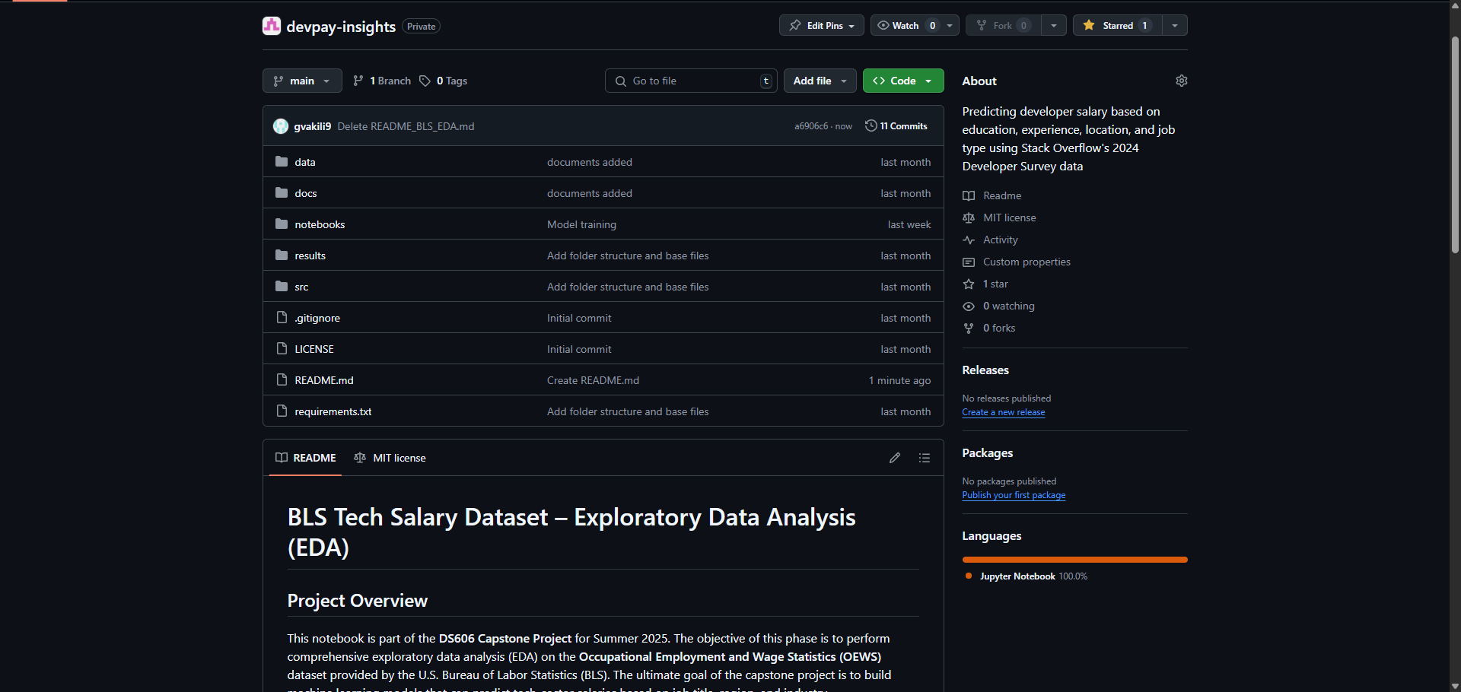
screenshot of the GitHub repo homepage
Notes:
“Here’s a quick look at our GitHub repository. As you can see, it’s organized with clearly labeled folders and a detailed README.
The README at the bottom walks through our project scope, methodology, and datasets. This structure ensures that both our instructors and external users can easily follow our workflow.
You’ll also find direct links to our exploratory data analysis notebooks, model training scripts, and visual output files, all of which are updated regularly.
All our progress, from exploratory notebooks to final slides, is documented and browsable on our GitHub. We’ve kept the README updated and linked all key files for reproducibility.
This snapshot is a good example of how we’ve made our work reproducible, transparent, and easy to navigate for future collaborators or reviewers.”

Slide 4
Project Summary and Objective
Project Title:
Predicting Tech Salaries: A Data-Driven Analysis of U.S. Labor Statistics
Objective:
Develop a supervised machine learning model to predict salaries in the U.S. tech sector. The project uses government labor statistics to identify how factors like occupation, industry, and geography influence compensation.
Why This Matters:
Enhances transparency in tech compensation
Informs policy, workforce planning, and career decision-making
Uses standardized, non-self-reported data for model reliability
ML Task:
Type: Regression
Target Variable: Annual median wage (A_MEDIAN)
Outcome: Predict salary across occupations and regions
Notes:
“Our project aims to predict tech-sector salaries using public U.S. labor data, specifically from the Occupational Employment and Wage Statistics dataset, or OEWS.
We’re developing a supervised machine learning model that estimates salaries based on key factors like occupation, region, and industry. This is a regression task, and our target variable is the annual median wage, labeled A_MEDIAN.
This project matters because existing salary tools often rely on self-reported data, which can be inconsistent, skewed, or difficult to verify. By using standardized, government-verified data, we’re able to build a more reliable and equitable model.
We see real-world applications here—for example, helping job seekers benchmark salaries, aiding policymakers in understanding regional disparities, and enabling organizations to create more transparent compensation structures.”

Slide 5
Primary Dataset: U.S. Bureau of Labor Statistics (OEWS)
Source:
U.S. Bureau of Labor Statistics (BLS)
Download Link
Dataset Properties:
~400,000 records → ~92,000 after filtering for tech-related jobs 32 columns
Covers all U.S. states, territories, and metro regions
Includes wage, employment, occupation, and industry data
Format: Excel (XLSX), government-verified, public domain
Key Variables:
OCC_TITLE: Occupation title
AREA_TITLE: Region
NAICS_TITLE: Industry sector
TOT_EMP: Total estimated employment
A_MEDIAN, A_MEAN: Median and mean annual wage
After Cleaning (for modeling)
17,398 records
27 columns
Notes:
“We’re using the 2024 Occupational Employment and Wage Statistics dataset from the U.S. Bureau of Labor Statistics. It initially includes around 400,000 records and 32 columns, covering wage and employment data across all U.S. states, territories, and metro areas.
While the raw dataset contains approximately 400,000 records, we filtered it to retain only tech-related occupations, resulting in about 92,000 records that were used for analysis.
It’s a public, government-verified dataset published in Excel format and commonly used in labor market research and policymaking.
Key features include occupation titles, industry sectors, regional identifiers, and total estimated employment. Our main focus is on wage variables—specifically A_MEAN and A_MEDIAN—which serve as our targets.
After cleaning for completeness and quality, we’re working with 17,398 records and 27 columns, giving us a refined, high-quality dataset for modeling.”

Slide 6
What Has Been Done Before?
Existing Approaches:
Stack Overflow Developer Survey: Used in many community dashboards and salary comparison tools; primarily descriptive.
Glassdoor & Levels.fyi Studies: Self-reported data analyzed using simple regression or filtering by job title and location.
BLS Reports: Government publications often visualize wage distributions but lack predictive modeling.
Common Limitations:
Heavy reliance on self-reported data, often international and inconsistent.
Most work is descriptive, lacking predictive or inferential modeling.
Limited integration of structured public datasets like BLS OEWS.
Often uses proprietary, non-generalizable standards
Notes:
A lot of the existing work on tech salaries relies on self-reported data. The Stack Overflow Developer Survey, for instance, powers many dashboards and salary calculators, but it's primarily descriptive—it tells us what respondents earn but doesn’t model the factors behind those earnings.
Similarly, sites like Glassdoor and Levels.fyi use user submissions to show ranges by role and location, but again, that data is often incomplete or skewed by selective reporting.
Even government sources like BLS reports tend to stop at summary statistics and visualizations—they don’t go deeper into predictive modeling.
Across the board, most tools suffer from the same limitations: they rely on self-reporting, they’re often international or inconsistent, and they rarely make use of structured, public datasets like OEWS.
That’s where our project fills the gap. We're building a predictive model using verified, U.S.-focused, structured data with regional and occupational detail that’s often missing elsewhere.”

Slide 7
Filling the Gaps: Our Distinctive Approach
Gaps in Prior Work:
Our Contribution:
Optional Extensions:
Minimal use of structured, U.S. government labor datasets in machine learning
Few predictive models using regional and occupational features
Lack of reproducibility in dashboards and survey-based tools
Public, reproducible data: Using the BLS OEWS dataset, which is standardized and verifiable
Predictive Modeling: Implementing regression to forecast salaries across occupations and regions
Feature Engineering: Incorporating geographic, occupational, and industry-level variables Transparent Workflow: Full pipeline documented and version-controlled on GitHub
Clustering occupations and regions
Cross-validating insights with the Stack Overflow Developer Survey (2024)
Notes:
“So how is our work different from what's already out there? First, there's very little predictive modeling done using structured U.S. government labor datasets like OEWS. Most tools are descriptive and rely on survey data, which lacks standardization.
We're addressing that by building a regression model using public, verifiable data that’s updated annually. Our approach incorporates regional, occupational, and industry-level features, which we’ve engineered from raw columns like OCC_TITLE, AREA_TITLE, and NAICS_TITLE.
Everything is version-controlled and documented in our GitHub repo, making our pipeline reproducible and transparent.
Looking ahead, we plan to enhance our model by clustering similar occupations or regions and integrating insights from the Stack Overflow Developer Survey as a secondary reference point. That’ll let us see where crowd-sourced patterns align—or diverge—from standardized labor data.”

Slide 8
Preparing the BLS OEWS Dataset for Modeling
Cleaning & Filtering Steps
Loaded raw Excel file into a DataFrame using pandas
Dropped rows with suppressed or missing wage and employment data
Filtered out:
Summary/aggregate rows (e.g., “All Occupations”)
Invalid or unknown area codes
Records with placeholder or zero salary values
Standard Occupational Classification (SOC) codes Group Filtering: We filtered only major occupation groups relevant to tech through federal code standards → Example: 15-xxxx = Computer and Mathematical Occupations
Keyword Filtering: We further filtered job titles using tech-related keywords such as “developer,” “engineer,” “data,” “IT,” and “cyber.”
Notes:
“This slide shows how we cleaned and filtered the BLS dataset before modeling.
First, we loaded the raw Excel file using pandas and immediately removed rows with suppressed or missing wage and employment values. We also filtered out non-specific entries like ‘All Occupations’, unknown area codes, and records with zero or placeholder salary values.
Next, we applied two levels of occupational filtering. The first was based on SOC codes—we retained only major groups relevant to tech, such as Computer and Mathematical Occupations, which begin with the code ‘15’.
Then we layered on keyword filtering to catch specific job titles with terms like 'developer', 'engineer', 'data', 'IT', and 'cyber'. This helped us focus on actual tech roles while excluding unrelated fields that might’ve slipped through.
These cleaning steps were essential for improving model accuracy and ensuring we didn’t dilute the dataset with irrelevant roles.”

Slide 9
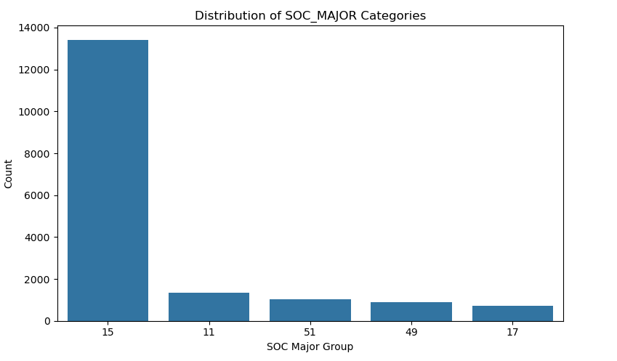
Notes:
“After filtering, we broke down the dataset by SOC major groups to validate the composition of our tech-focused subset.
As shown here, the vast majority of roles fall into group 15, which is Computer and Mathematical Occupations—this includes job titles like software developers, data scientists, and statisticians.
We also see smaller but still meaningful representation from Management (group 11), Production (51), Installation and Maintenance (49), and Engineering (17).
This distribution confirms that our filtering was effective. It captured the tech core we’re interested in while retaining enough variation to support regional and industry comparisons later in our modeling pipeline.”

Slide 10
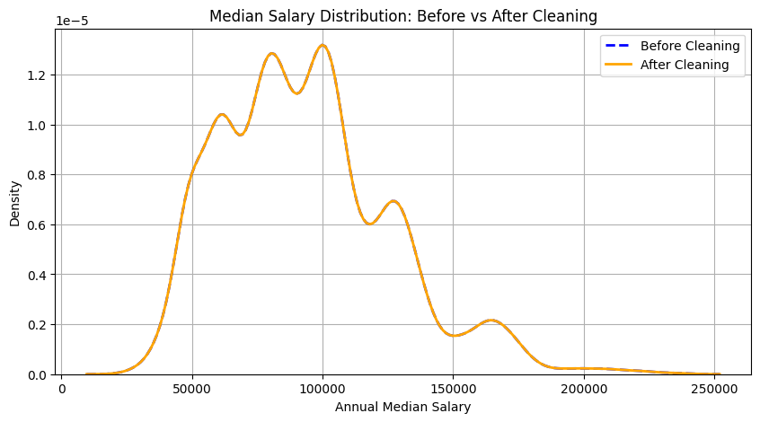
Preparing the BLS OEWS Dataset for Modeling
After Cleaning:
Unique job titles before cleaning: 29
Unique job titles after cleaning: 29
KDE plot, before and after cleaning was plotted, the shape and range of the distribution remain consistent, confirming that we did not lose valuable salary insights during the cleaning process.
Notes:
“After cleaning, we wanted to validate that we didn’t accidentally lose meaningful salary data or distort the distribution.
The line chart here is a KDE plot comparing the distribution of annual median wages before and after cleaning. As you can see, the shapes are nearly identical, which means we retained the full range and character of the original salary data.
Also, we confirmed that the number of unique tech job titles remained stable—29 both before and after cleaning.
This validation step gave us confidence to move forward with modeling, knowing our dataset was both clean and representative.”

Slide 11
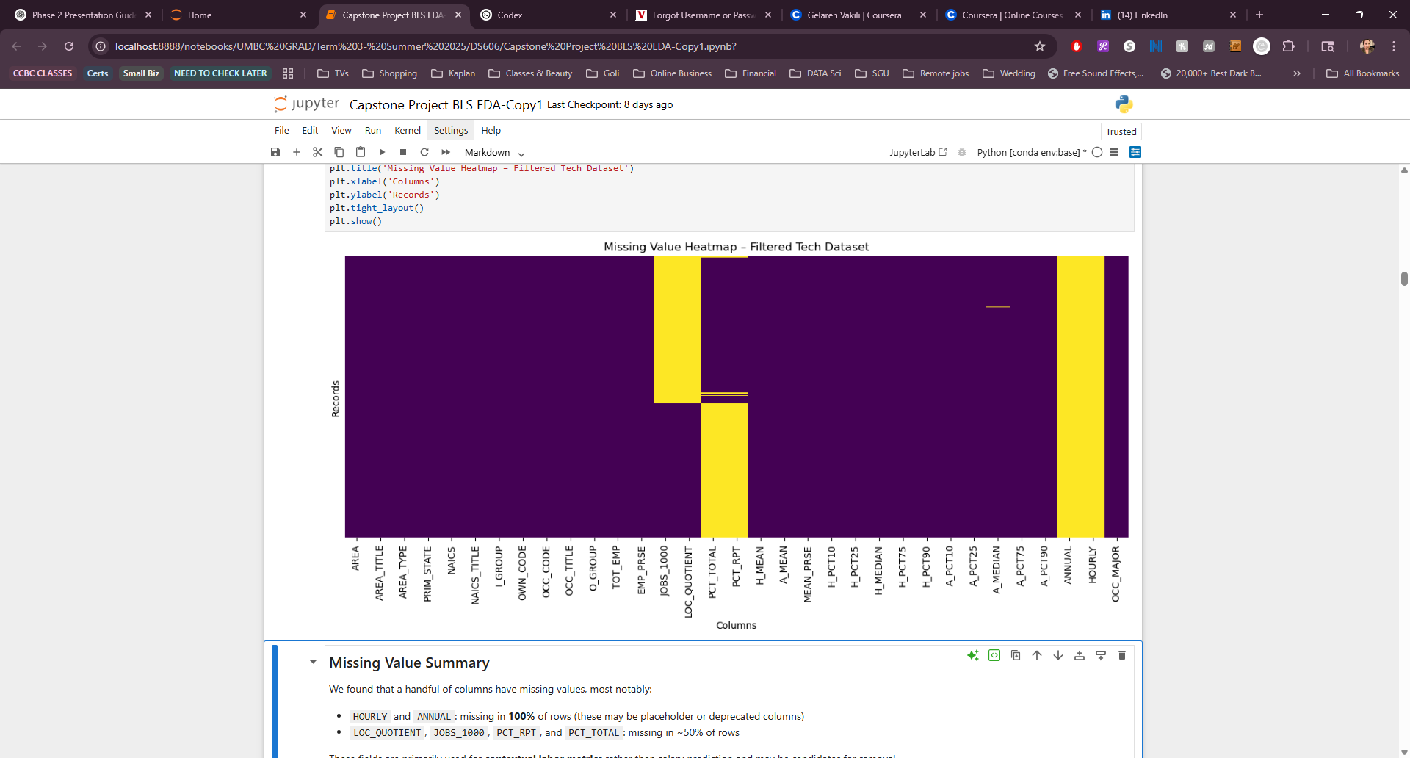
Preparing the BLS OEWS Dataset for Modeling
Handling Missing Values:
Columns with 100% missing values were removed
Sparse features were reviewed for possible aggregation
Null checks and percentage summaries were performed across all features
Missing Value Heatmap To assess data quality, we visualized missing values across all columns in the filtered tech dataset. The heatmap reveals that most key features (occupation, region, salary, employment) are well-populated, with only a few columns requiring further review or removal. This step ensured that we proceeded with a clean and reliable dataset for analysis and modeling.
Notes:
“To make sure our model was built on reliable data, we performed a full audit of missing values.
First, we dropped columns that were 100% null—those were typically unused placeholders like HOURLY or deprecated wage fields.
Then, we reviewed sparsely populated columns for possible aggregation or removal. We checked null percentages across all features to make sure our decisions were informed.
The heatmap on this slide visualizes missing data across all columns. As you can see, the vast majority of key fields—like occupation, location, salary, and employment—are complete. Only a few peripheral fields had gaps.
This step helped us confirm that our tech-filtered dataset was clean, trustworthy, and ready for encoding and modeling.”

Slide 12
Preparing the BLS OEWS Dataset for Modeling
Feature Selection:
Kept modeling-relevant fields:
OCC_TITLE (occupation)
AREA_TITLE (location)
NAICS_TITLE (industry)
TOT_EMP (employment count)
A_MEDIAN / A_MEAN (target variables)
Prepared categorical variables for encoding:
Grouped overly specific titles into broader categories
Reserved space for encoding via one-hot or label methods
Notes:
“Once we cleaned the dataset, we focused on selecting only the features relevant for modeling.
We kept key columns like OCC_TITLE for job title, AREA_TITLE for region, and NAICS_TITLE for industry sector. We also retained TOT_EMP for employment estimates and our target variables: A_MEDIAN and A_MEAN salary.
Since many of these are categorical, we planned for encoding. For example, very specific job titles were grouped into broader occupation categories so we could simplify the input space.
We reserved the next stage of preprocessing for applying one-hot or label encoding depending on what worked best for our chosen models.”

Slide 13
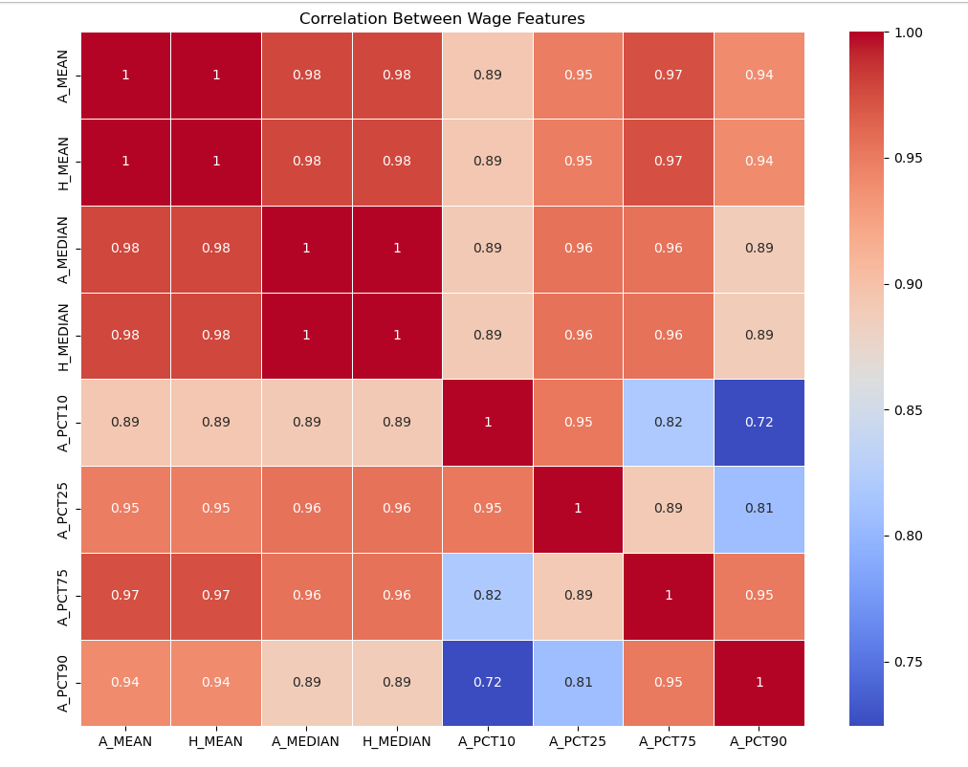
Exploring Tech Salary & Employment Patterns
Cleaned dataset used to analyze salary trends across U.S. tech occupations and regions
Visualized distributions, correlations, and regional disparities
Confirmed strong linear relationships between wage fields (e.g., A_MEAN, A_MEDIAN)
Notes:
“Here we began our exploratory analysis of the cleaned tech dataset. The goal was to understand how salaries vary across occupations, regions, and other structural factors.
The correlation heatmap shown here helped us verify redundancy and relationship strength between our main salary features — for example, A_MEAN and A_MEDIAN are nearly perfectly correlated, so we considered retaining only one for modeling to reduce multicollinearity.
Additionally, some percentile-based wage fields had lower correlations with each other and with the median and mean, which might offer complementary information during feature selection or clustering.
This step was key to confirming our dataset’s internal consistency before we moved into modeling.”

Slide 14
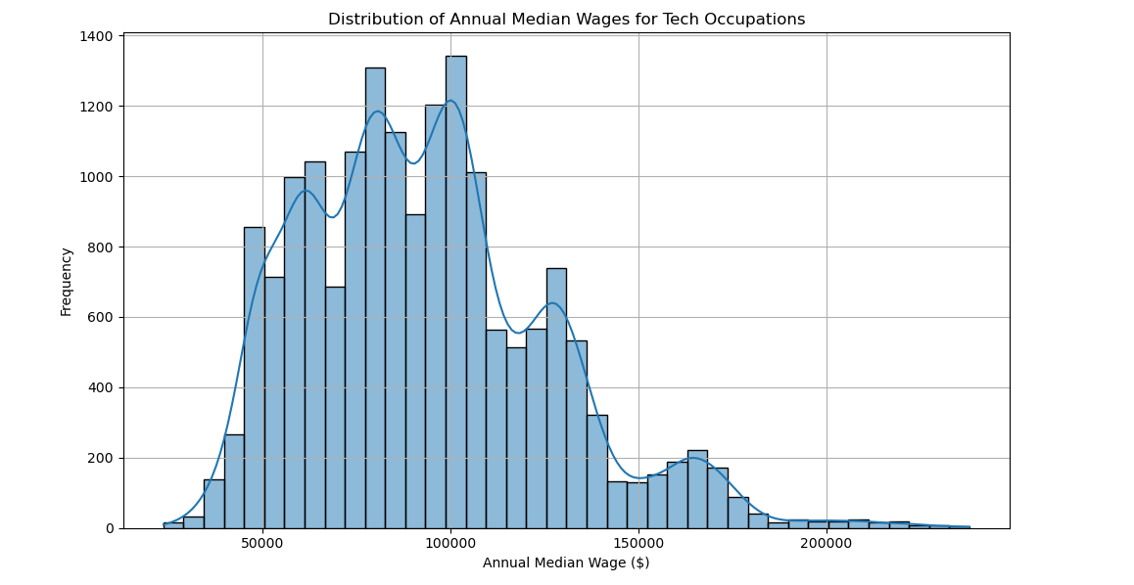
Distribution of Tech Occupation Median Wages
Notes:
“This histogram displays the distribution of annual median wages across tech occupations in the U.S.
As you can see, the majority of wages fall between $80,000 and $120,000, with a noticeable peak just above $100,000. There’s a long right tail showing higher-wage roles, likely representing specialized or senior-level positions.
The slight dips or gaps may correspond to suppressed or less frequently reported occupations, but overall the distribution appears relatively normal with a positive skew.
This visualization helped us validate salary consistency and informed our approach to outlier detection and normalization for modeling.”

Slide 15
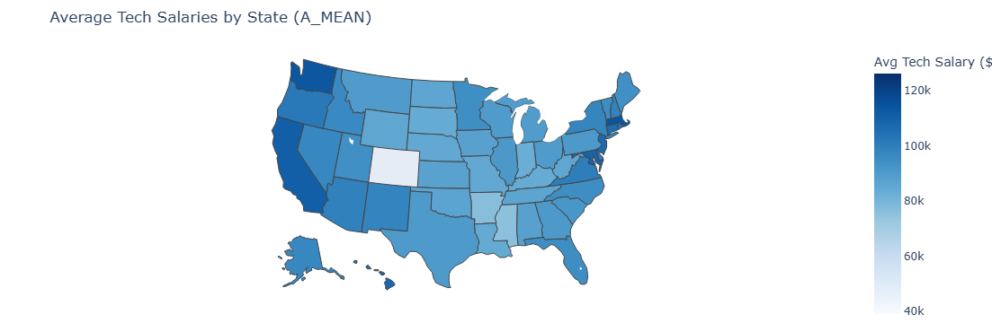
Average Tech Salaries by State
Notes:
“This choropleth map shows the average tech salaries across U.S. states, using the A_MEAN field from the BLS dataset.
As expected, states like California and Washington stand out with higher average salaries—likely due to the concentration of tech hubs and cost of living.
Conversely, some central states reflect lower averages, which might indicate fewer high-paying tech jobs or lower living costs.
This state-level breakdown gave us a clearer picture of geographic wage disparities and will help us evaluate the importance of location in our modeling.”

Slide 16
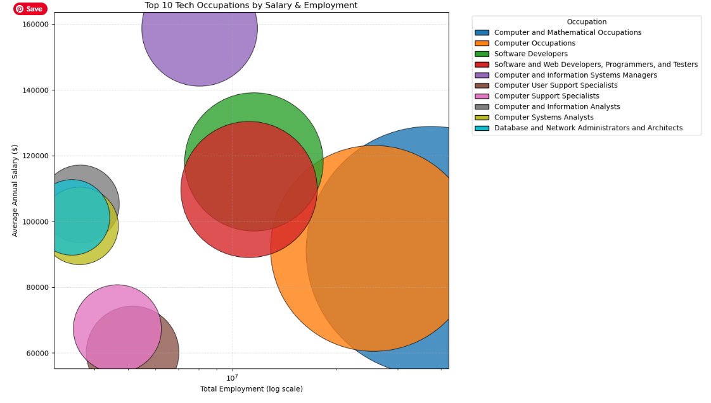
Top 10 Tech Occupations by Salary & Employment
Notes:
“This bubble chart illustrates the top 10 tech occupations, showing the relationship between total employment (on the x-axis) and average annual salary (on the y-axis).
Each bubble’s size represents the number of employees, while color indicates the occupation category.
We can see that some roles, like Software Developers and Computer Systems Analysts, have both high employment and strong salaries, making them central to the tech job market.
On the other hand, certain niche roles show high salaries but relatively low employment, which may point to specialized skill sets or limited demand.
This visualization helped us identify which job titles carry the most predictive weight for our salary model and informed our feature selection process.”

Slide 17
Modeling Approach and Training Process
Target variable & Models Trained
Features used
A_MEDIAN (annual median wage)
Ridge Regression
Random Forest Regressor
Encoded:
OCC_TITLE,
AREA_TITLE,
NAICS_TITLE,
TOT_EMP
Data split
Feature encoding
Training: 70%
Validation: 15%
Testing: 15%
One-hot for categorical features
Notes:
“Now that we explored the data, we moved on to model training.
Our target variable was A_MEDIAN, the annual median wage. We chose two supervised regression models for comparison: Ridge Regression, which handles multicollinearity well, and Random Forest Regressor, which captures non-linear relationships.
We trained the models using the features most relevant to our prediction goal—occupation (OCC_TITLE), location (AREA_TITLE), industry (NAICS_TITLE), and employment count (TOT_EMP).
All categorical features were one-hot encoded, and we reserved numeric ones as-is.
For robust evaluation, we split the dataset into:
70% training,
15% validation,
15% testing.
This setup helped us minimize overfitting and tune hyperparameters effectively.”

Slide 18
Model Performance & Comparison
Metric Used: Root Mean Squared Error (RMSE)
Validation Results:
Ridge Regression: RMSE = 29,922.20
Random Forest: RMSE = 17,495.56
Ridge Cross-Validation (5-Fold):
Mean RMSE = 31,261.60
Test Set Performance:
Random Forest Test RMSE: 17,502.32
Notes:
“We evaluated two models—Ridge regression and Random Forest—using RMSE as our primary metric because it emphasizes larger prediction errors, which is critical for wage prediction.
Ridge regression gave us a validation RMSE of around 29,922, but its 5-fold cross-validation average was slightly higher at about 31,262. In contrast, the Random Forest model performed significantly better, with a validation RMSE of 17,495 and a test RMSE of 17,502, indicating consistent performance across datasets.
We used 5-fold cross-validation with Ridge regression to ensure robustness. This helps reduce variance and validate model performance across different splits.
These results show that Random Forest is currently our best-performing model, likely due to its ability to capture complex, nonlinear relationships that Ridge regression may miss.”

Slide 19
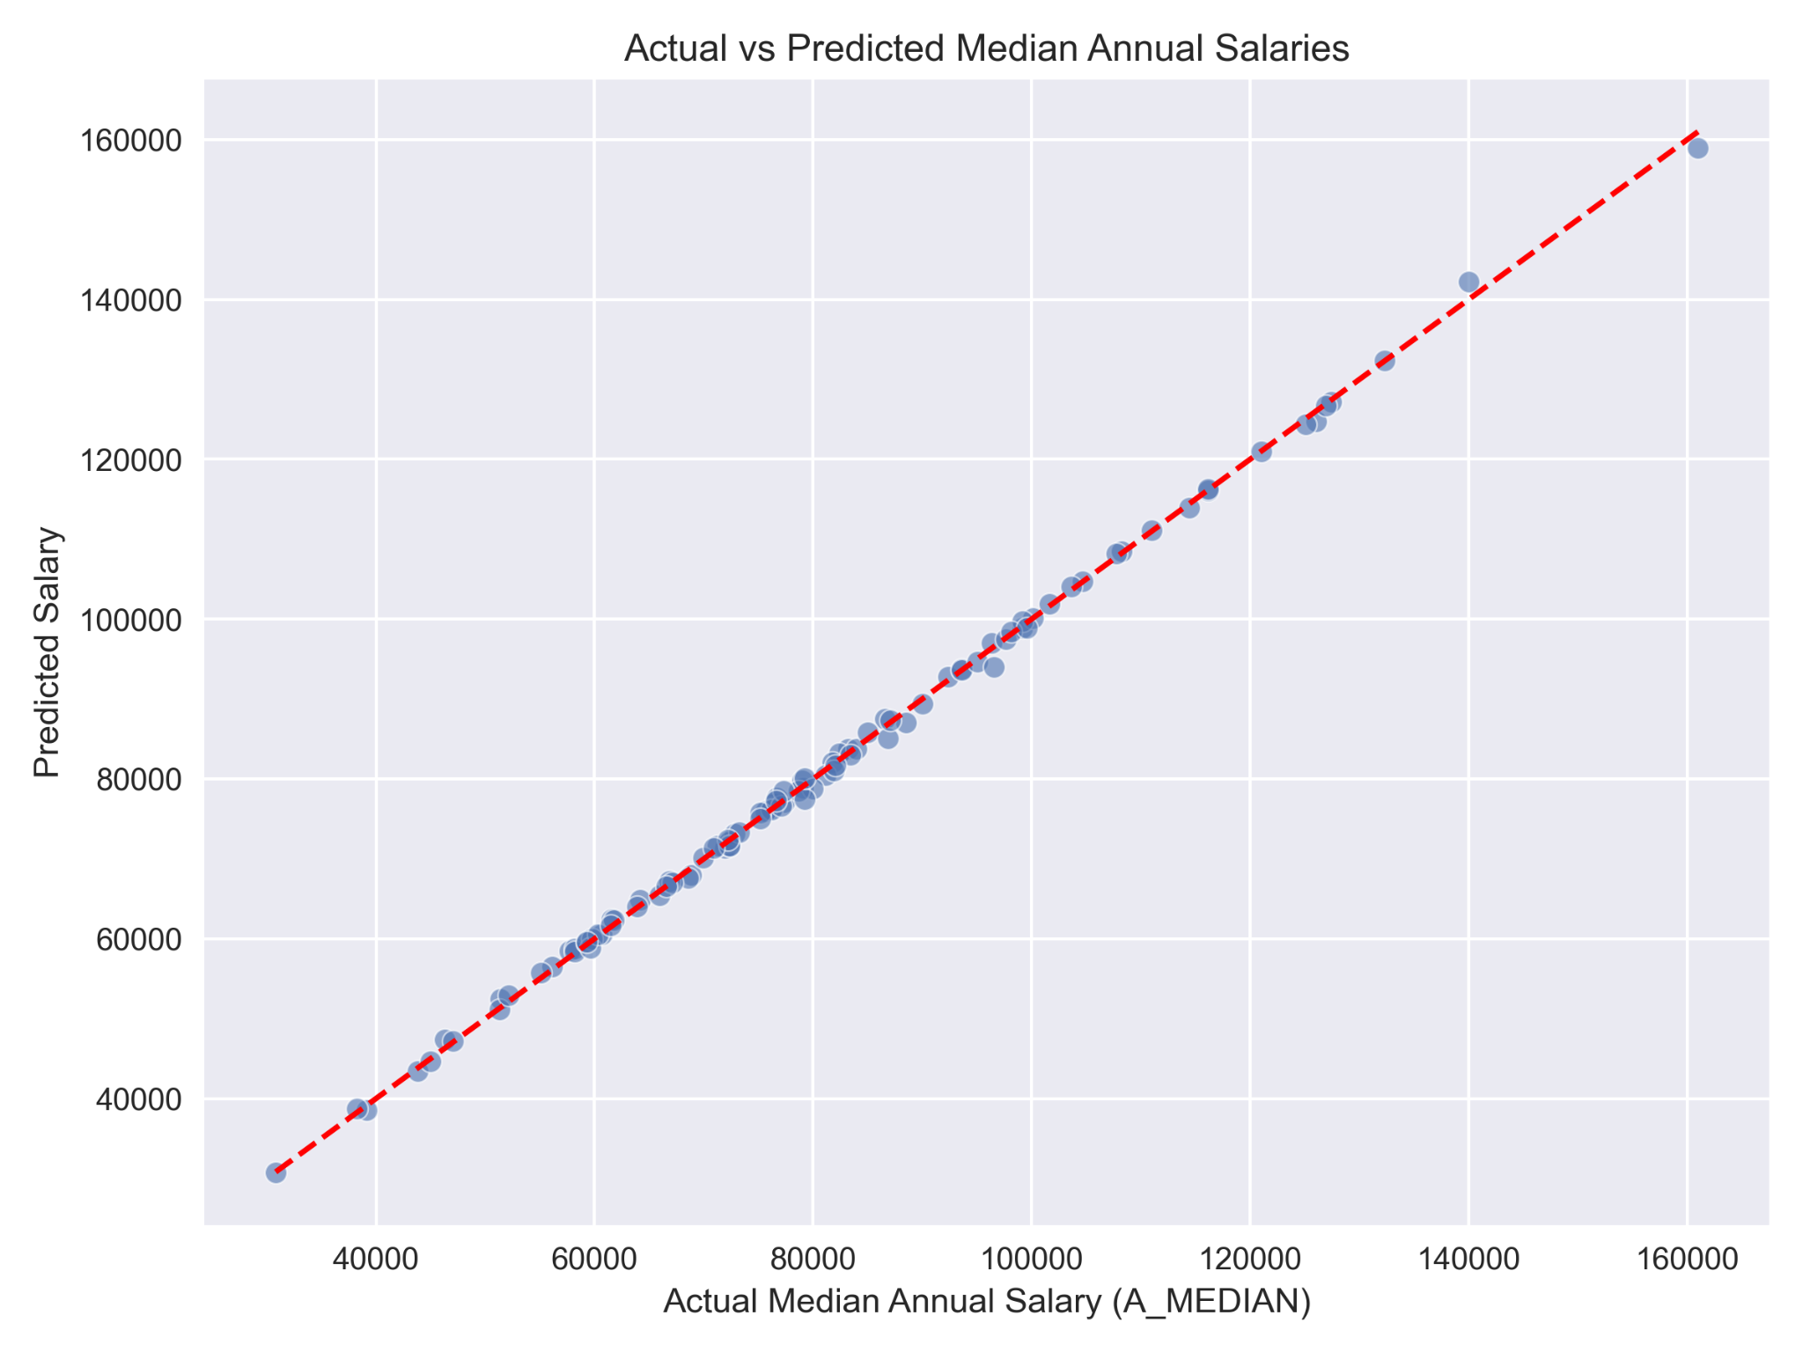
Ridge Model Performance Visualization
Notes:
“Here are some of the visualizations that we’re using to further evaluate the performance of the models. For the Ridge regression we plotted the actual salaries against our predictions in order to visualize the accuracy of our model and try to visually detect potentially bad regularization strength, see if there were particular ranges where the model performed better or worse, and identify outliers that could suggest that our model is missing robustness in capturing behaviours in the data.

Slide 20
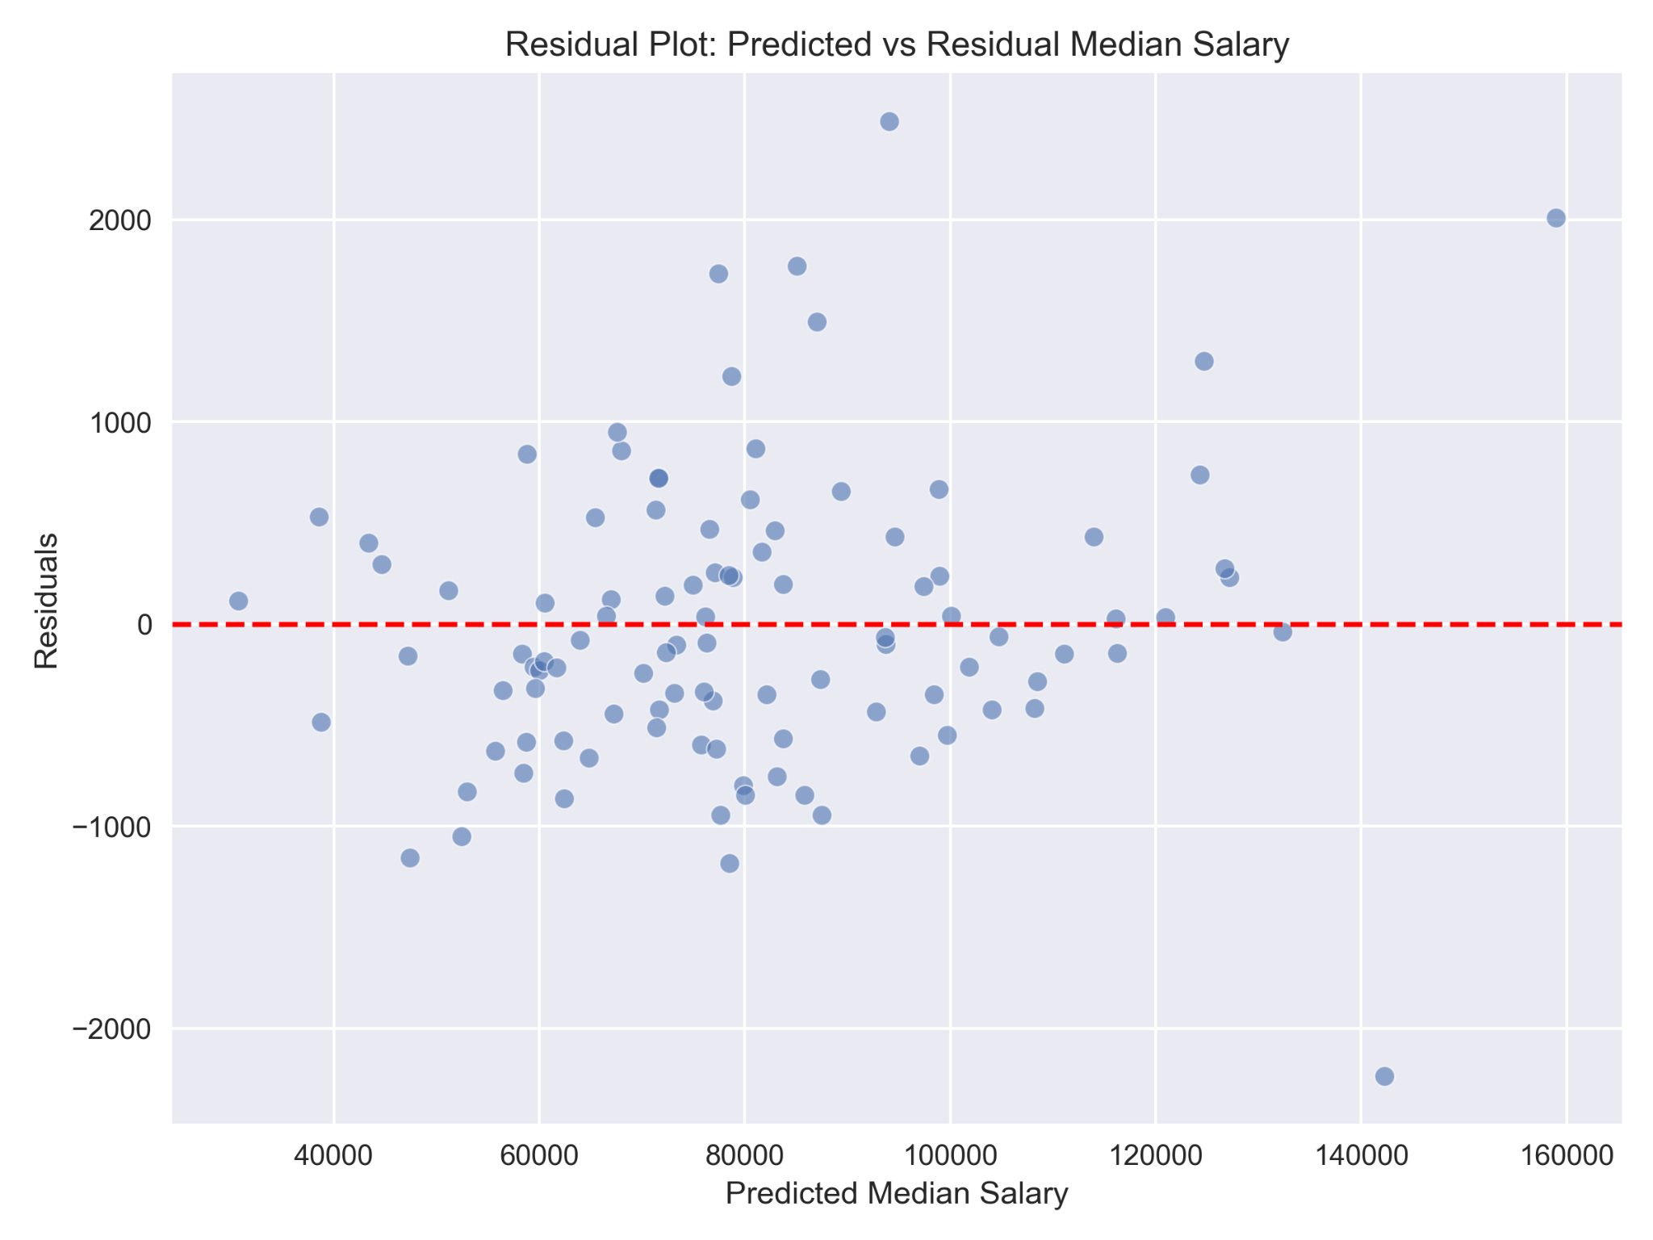
Ridge Model Performance Visualization
Notes:
“Additionally, our next visualization to evaluate model performance was to plot the predicted values against the residual for each salary prediction. As the residuals are defined as the difference between our actual salary values and our predicted values, a plot like this can validate the linearity and constant variance assumptions necessary to run a ridge model, and function as an additional visual method to identify potential outliers and bias from regularization in order to improve model performance in phase 3.

Slide 21
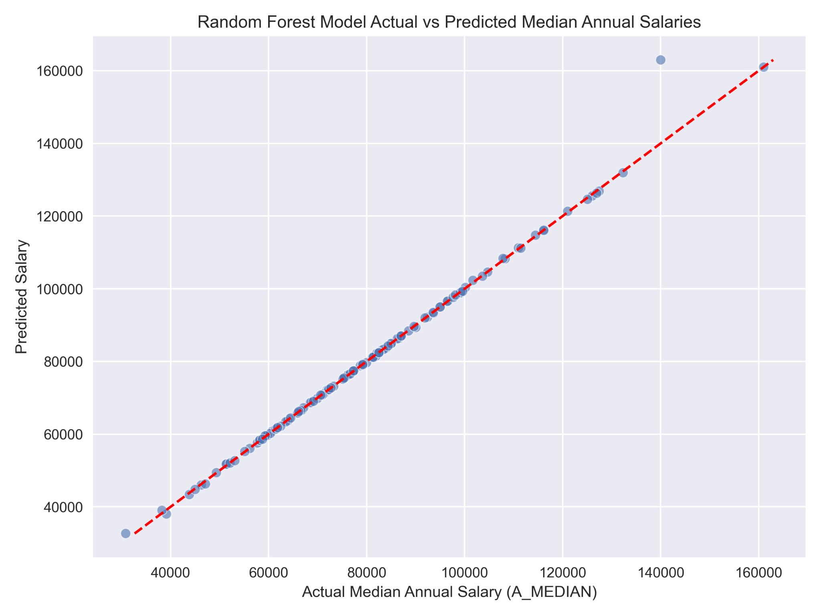
RF Model Performance Visualization
Notes:
“We are also using a random forest model in this project, and as it could prove insightful to compare and contrast these models not just against themselves but pre-existing attempts at salary prediction, we performed the same operations and created the same plots for the random forest model as well. Again a plot like this will help in detecting bias in predictions, checking for potential fit issues, and having a visual method to compare model performance. In contrast to ridge regression, this plot shows that we have less clustering around the 80k salary range, but also have a more noticeable outlier in the higher range, indicating that there is more work to be done in improving model performance.”

Slide 22
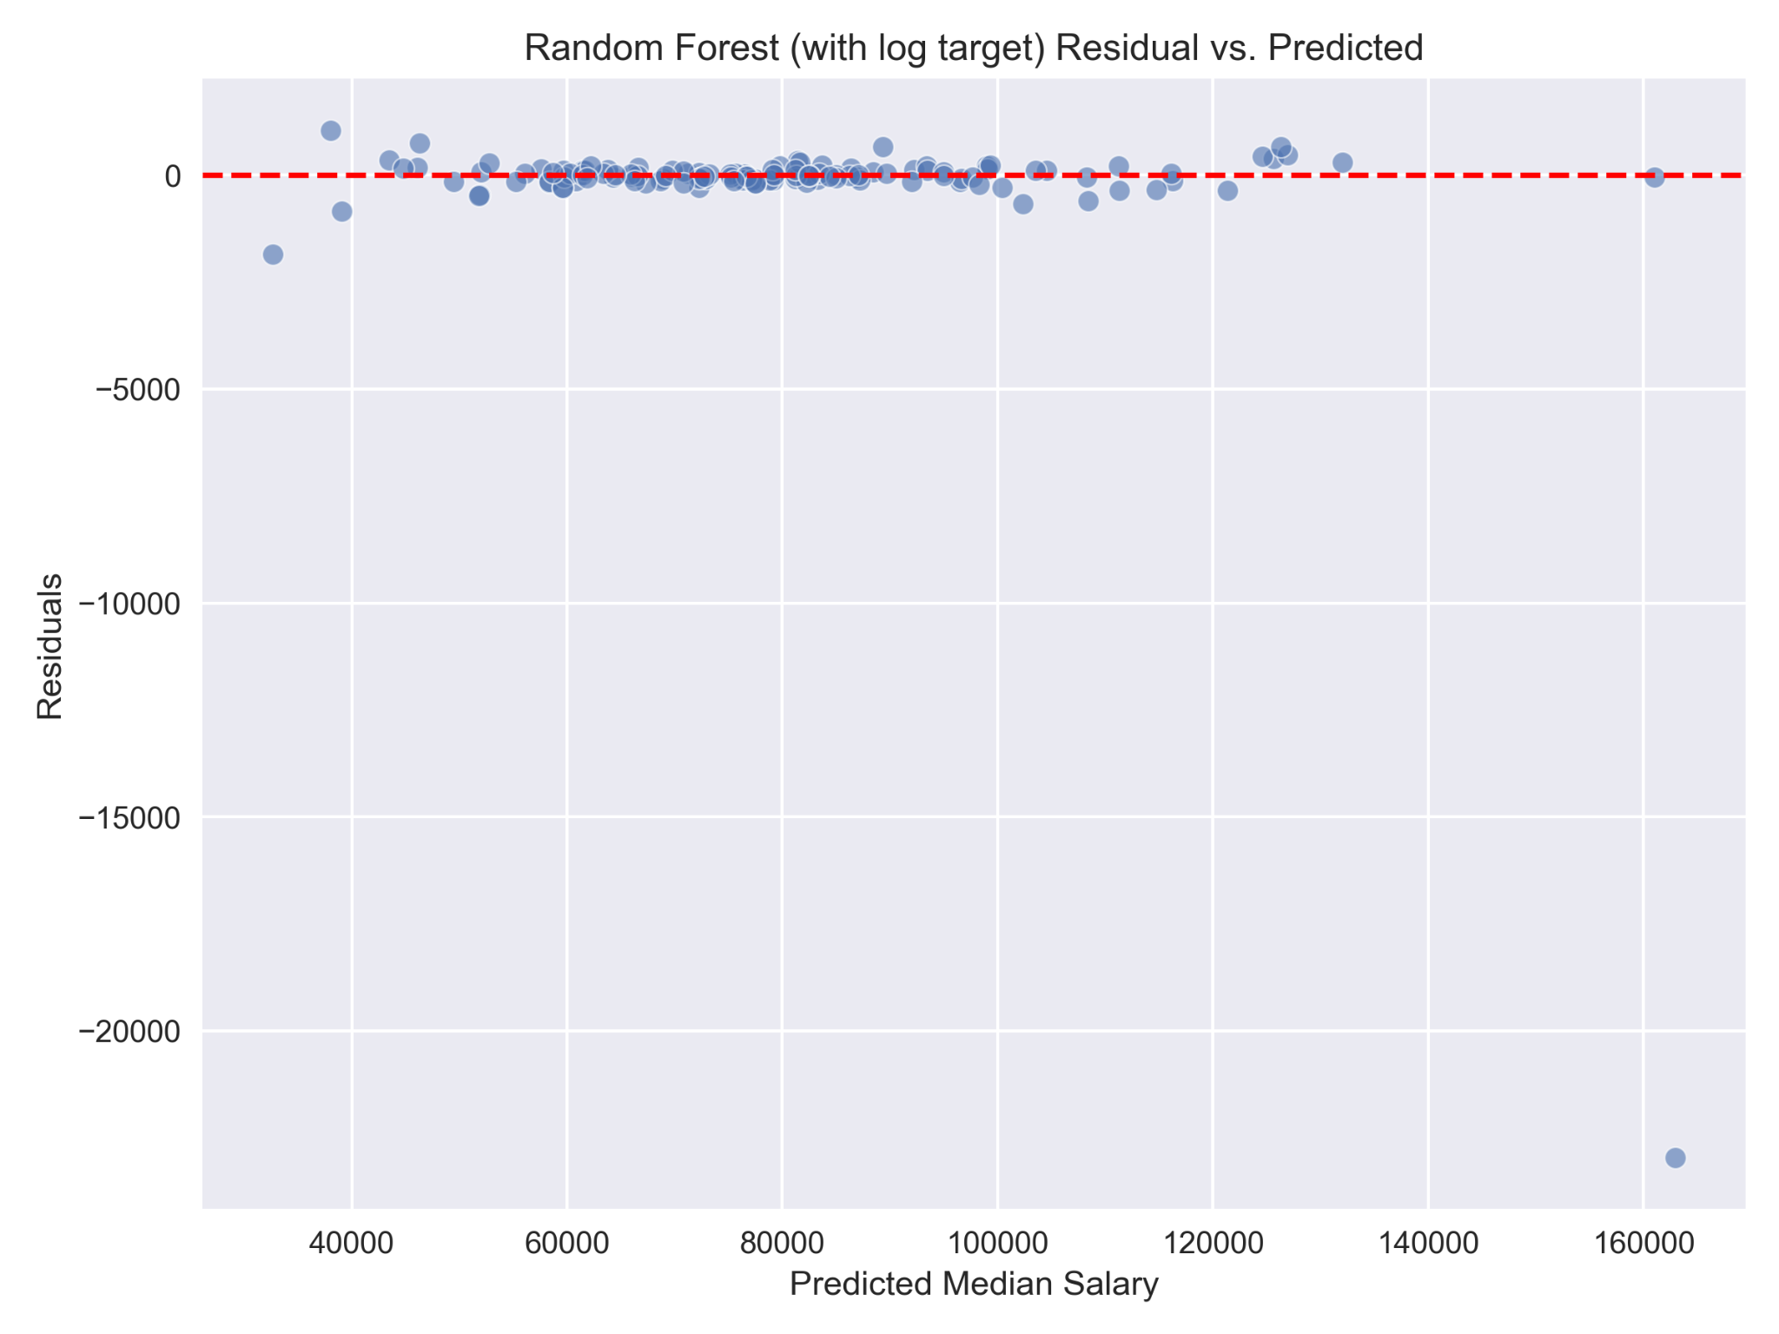
RF Model Performance Visualization
Notes:
“This was one of the more interesting visualizations to come out of preliminary model evaluation. Like with ridge regression, plotting the residual vs predicted salary allows for a method to detect prediction bias, check variance consistency, and most importantly here – identifying outliers. As you can see there is not only a very clear outlier at the higher end of the salary range but potentially other outliers at the lowest end as well, although the high range outlier skews the plot so much it becomes difficult to tell for the other points. This clearly indicates that more work is needed, either data cleaning (addressing something we may have missed), or potential model adjustments for improvement.”

Slide 23
Timeline and Future Milestones
Phase 0: Team Formation & Project Pitch
Phase 1: Literature Review & Initial EDA
Phase 2: EDA & Model Construction (Current)
Phase 3: Interpretation & Iteration (Upcoming)
Finalized topic, collected datasets, and defined objectives
Conducted initial data cleaning and EDA previews
Delivered P1 presentation with cleaned data and baseline analysis
Compared project against state of the art and refined scope
Completed full EDA, visualizations, and cleansing
Trained and validated baseline models (Ridge, Random Forest)
Documented modeling workflow and results
Incorporated Phase 1 feedback by refining model scope and improving tech job filtering
Refine models, add clustering and advanced features
Integrate Stack Overflow dataset for comparative insights
Prepare final presentation and formal write-up
Final Deliverables – Week of 08/12
Submit final slide deck, notebook, and written report
Present findings and insights to full class
Notes:
“This slide outlines our project timeline across all four phases of the capstone.
In Phase 0, we formed our team, chose a research question around tech salary prediction, gathered datasets from BLS and Stack Overflow, and conducted initial data cleaning and previews of EDA.
During Phase 1, we delivered our first presentation using a cleaned subset of the BLS data, did a baseline comparison with existing literature, and sharpened our scope to focus on tech occupations across states.
In Phase 2, which is our current stage, Based on Phase 1 feedback, we refined our project scope to focus more narrowly on tech-related roles and adjusted our model inputs accordingly. we completed full EDA and transformations, trained baseline regression models, and began validating results. All this work has been documented in the GitHub repo.
Looking ahead to Phase 3, we plan to improve model performance, possibly by adding clustering or dimensionality reduction. We’ll also integrate the Stack Overflow dataset for cross-validation and richer analysis, especially to identify any mismatches between reported vs. surveyed salary expectations.
Our final deliverables are due the week of August 12—including the written report, polished slide deck, and final notebook submission.”

Slide 24
Risks & Mitigations
During Phase 2, we faced several practical challenges typical of large public datasets. A significant portion of the raw BLS data contained suppressed or missing values, which we addressed by filtering and retaining only complete, high-quality records. The categorical variables—especially job titles and regions—had high cardinality, which we found by testing for multicollinearity. This required thoughtful grouping and encoding to keep the model both interpretable and efficient. To reduce the risk of overfitting, we incorporated cross-validation and maintained a strict training/validation/test split. Finally, given the limited time frame, we prioritized a robust regression pipeline and deferred secondary analysis and clustering for the next phase.
Notes:
“During Phase 2, we encountered several challenges that are common when working with large, real-world public datasets.
First, a significant portion of the raw BLS data included suppressed or missing values. We mitigated this by filtering out incomplete rows and retaining only high-quality, fully reported records.
Next, we tackled the issue of high cardinality in categorical features like job titles and regions. We tested for multicollinearity, and based on the results, grouped and encoded features in a way that helped maintain both model interpretability and performance.
To avoid overfitting, we used strict training/validation/test splits and implemented cross-validation throughout the modeling pipeline.
And finally, due to time constraints, we focused our efforts on a robust regression pipeline and saved more exploratory or advanced modeling—such as clustering—for the next phase.”

Slide 25
What We’ve Done and Why It Matters
Built a reproducible pipeline using public U.S. labor data
Explored salary trends across tech occupations and regions
Constructed and evaluated regression models to predict wages
Highlighted disparities in compensation by role, location, and industry
Laid the groundwork for extended analysis in Phase 3
Notes:
“To summarize what we’ve accomplished in Phase 2:
We built a clean, reproducible pipeline using U.S. labor statistics—something that can be scaled or adapted for future analysis.
We explored salary trends by occupation, industry, and geography, helping us better understand how these variables shape tech compensation.
Using regression models like Ridge and Random Forest, we predicted annual wages and evaluated model performance through cross-validation and test results.
Along the way, we uncovered disparities in wages depending on job role, location, and sector—which could inform both job seekers and policy makers.
Most importantly, we laid a strong foundation for Phase 3, where we’ll expand our analysis using additional features, clustering, and the Stack Overflow dataset.”

Slide 26
Data Sources & Supporting Materials
Datasets:
U.S. Bureau of Labor Statistics (OEWS 2024) https://www.bls.gov/oes/special-requests/oesm24all.zip
Stack Overflow Developer Survey 2024 https://survey.stackoverflow.co/datasets/stack-overflow-developer-survey-2024.zip
Tools & Libraries:
Python 3.11, Pandas, NumPy, Seaborn, Matplotlib, Scikit-learn
Jupyter Notebook, GitHub
Background Reading:
Pedregosa et al. (2011). Scikit-learn: Machine Learning in Python. Journal of Machine Learning Research.
Stack Overflow Insights. (2024). Developer Survey Results.
U.S. Department of Labor. (2024). Occupational Employment and Wage Statistics (OEWS).
Notes:
“Our main dataset came from the 2024 BLS Occupational Employment and Wage Statistics, which gave us detailed salary data across roles, industries, and states.
We also plan to bring in the 2024 Stack Overflow Developer Survey in Phase 3 for comparison.
Our tools included Python, key libraries like Pandas and Scikit-learn, and we worked in Jupyter Notebooks with GitHub for collaboration.
Background reading guided our modeling choices and helped ensure we aligned with best practices.”

Slide 27
Thank you
Questions?
Notes:
“Thank you for your time and attention. We hope this work sparks meaningful discussion and look forward to your feedback!”

